Slide 1

Our Data Viz-ard Finalists!

Slide 2

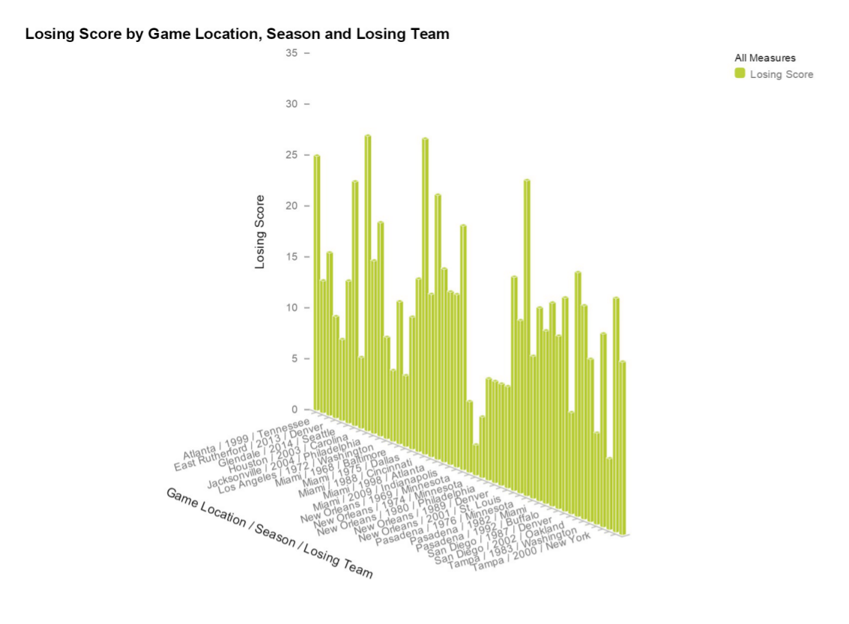
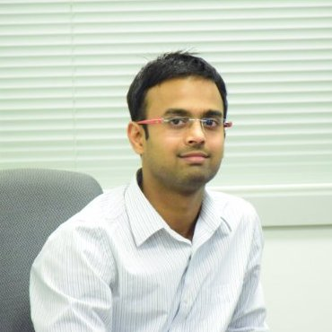

The Lumira Data Bowl 50 - Finalist
Certified
Data Viz-ard
Jitendra Sharma
Software Design & Development Intern
Palo Alto, Building 2

Slide 3
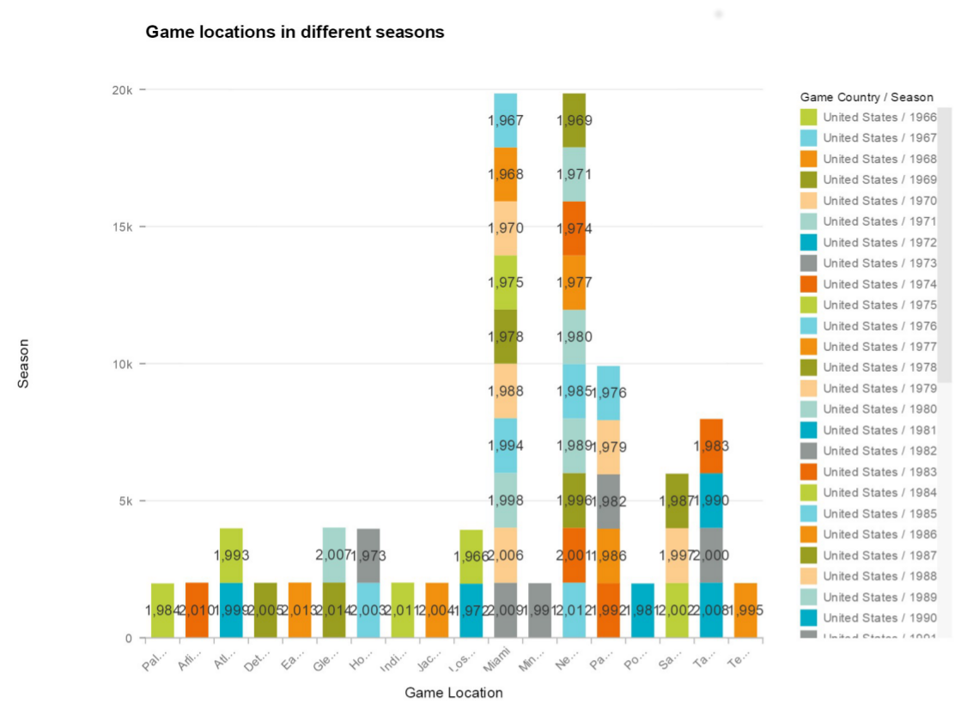
The Lumira Data Bowl 50 - Finalist
Certified
Data Viz-ard
Jitendra Sharma
Software Design & Development Intern
Palo Alto, Building 2

Slide 4
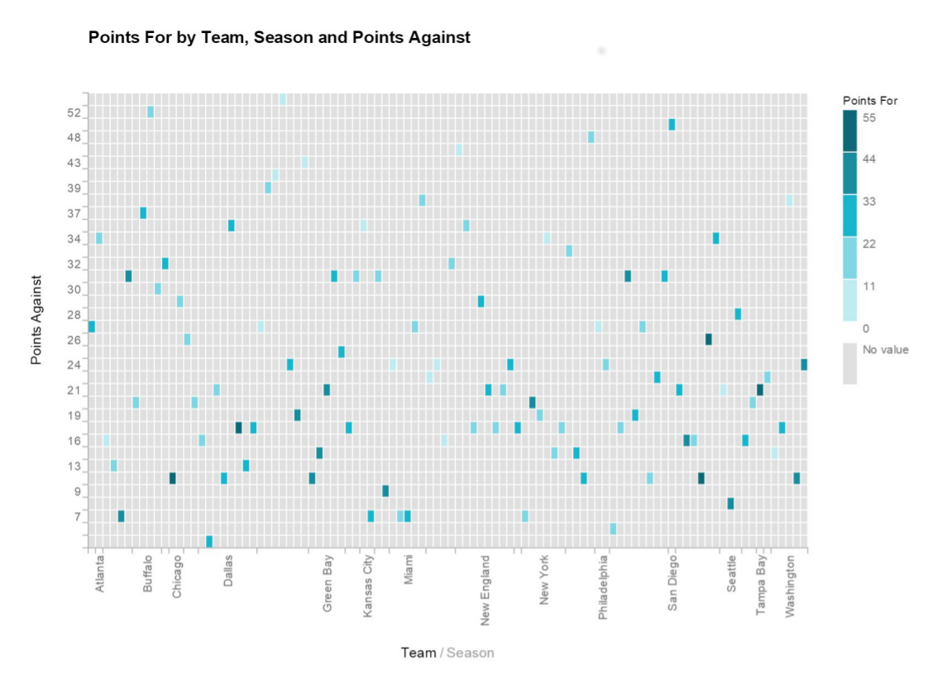
The Lumira Data Bowl 50 - Finalist
Certified
Data Viz-ard
Jitendra Sharma
Software Design & Development Intern
Palo Alto, Building 2

Slide 5
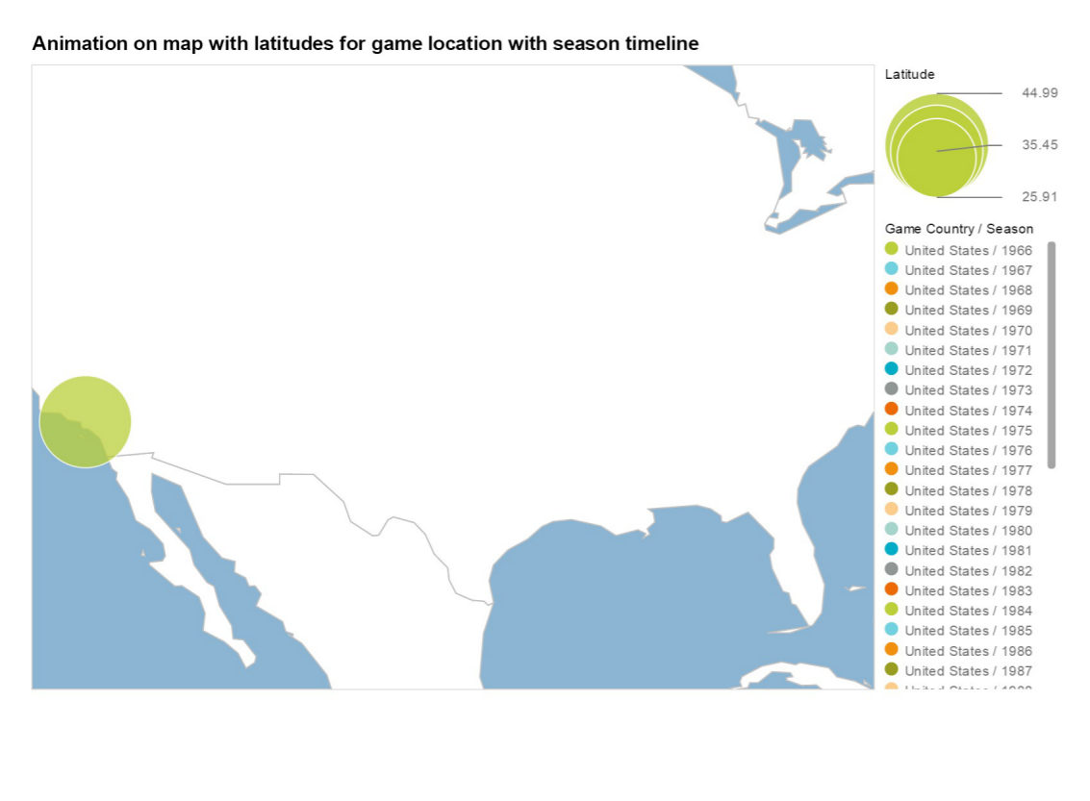
The Lumira Data Bowl 50 - Finalist
Certified
Data Viz-ard
Jitendra Sharma
Software Design & Development Intern
Palo Alto, Building 2

Slide 6
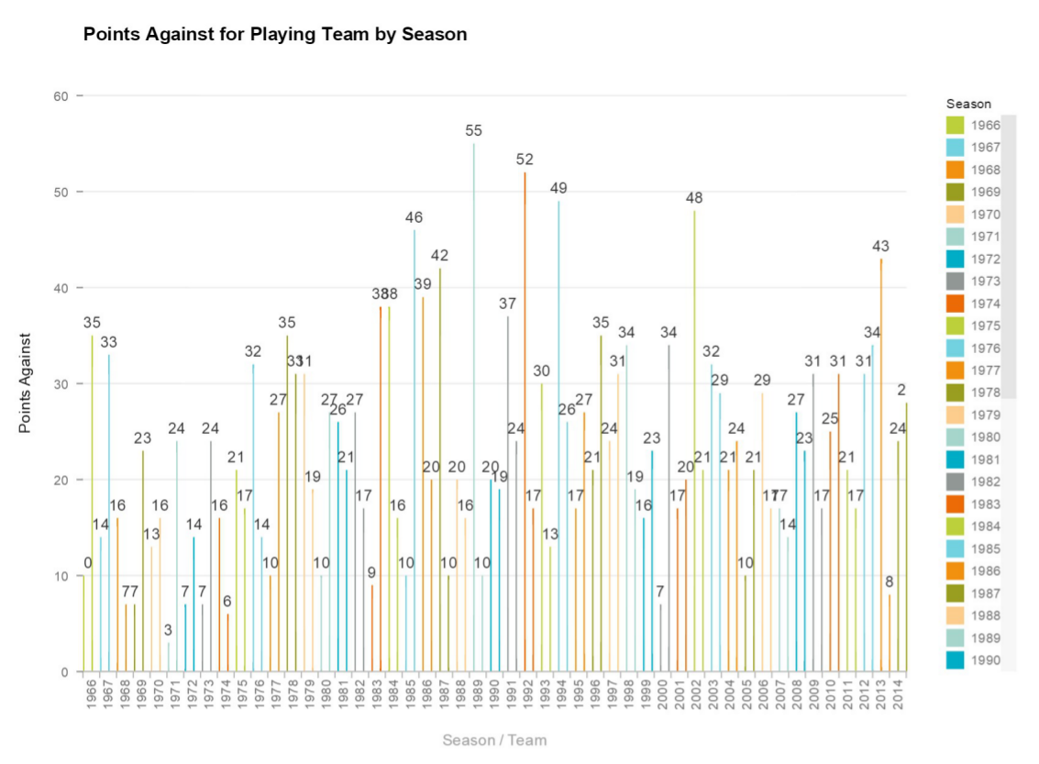
The Lumira Data Bowl 50 - Finalist
Certified
Data Viz-ard
Jitendra Sharma
Software Design & Development Intern
Palo Alto, Building 2

Slide 7

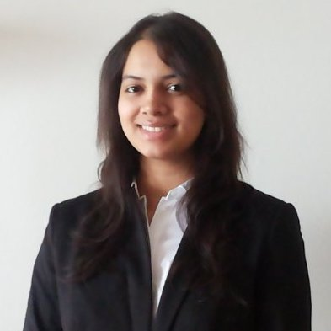


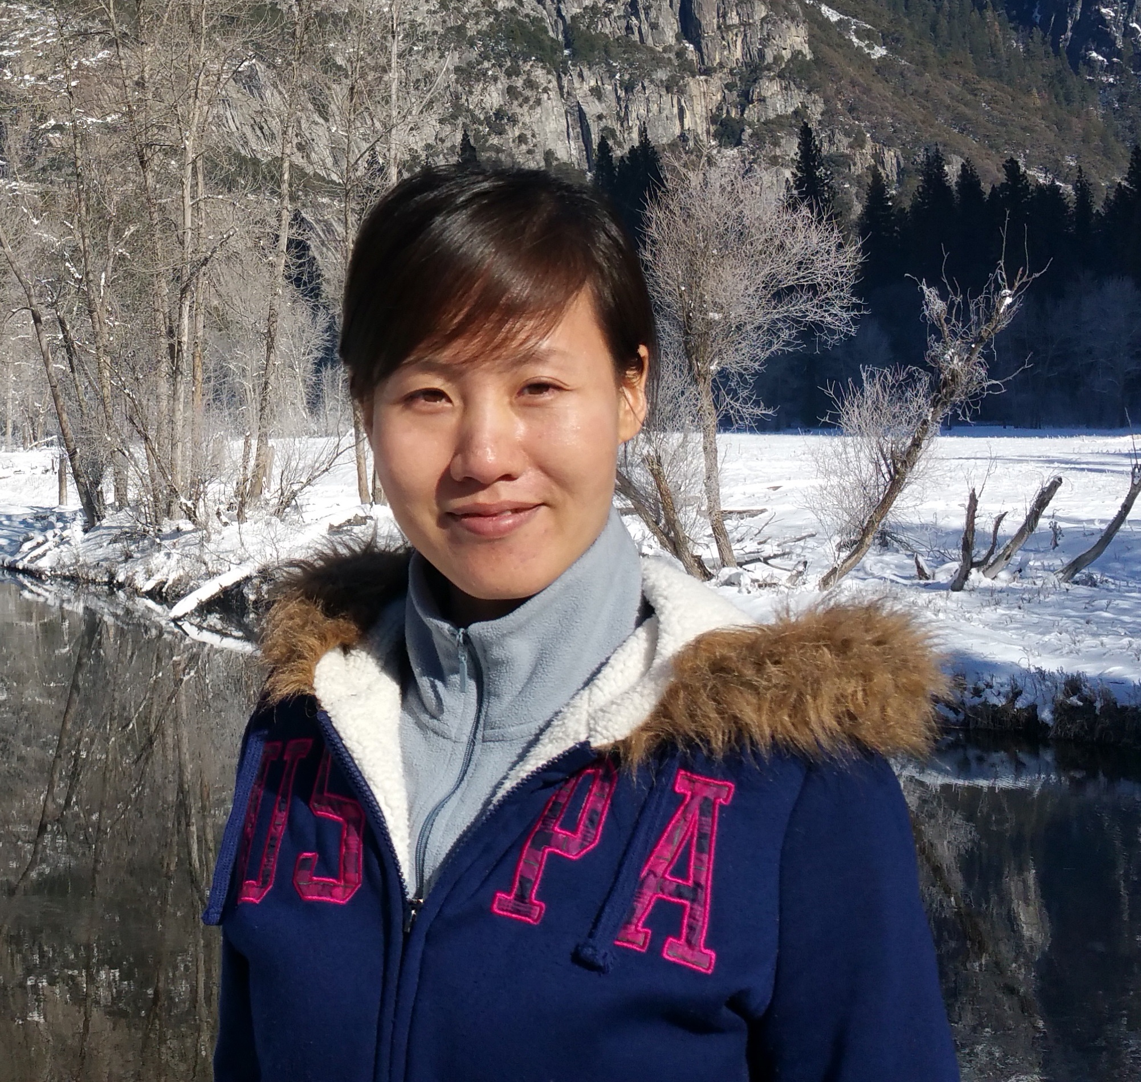
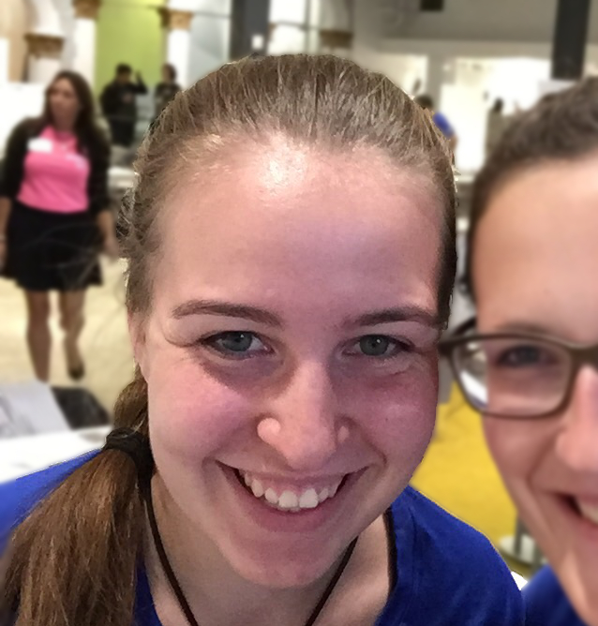
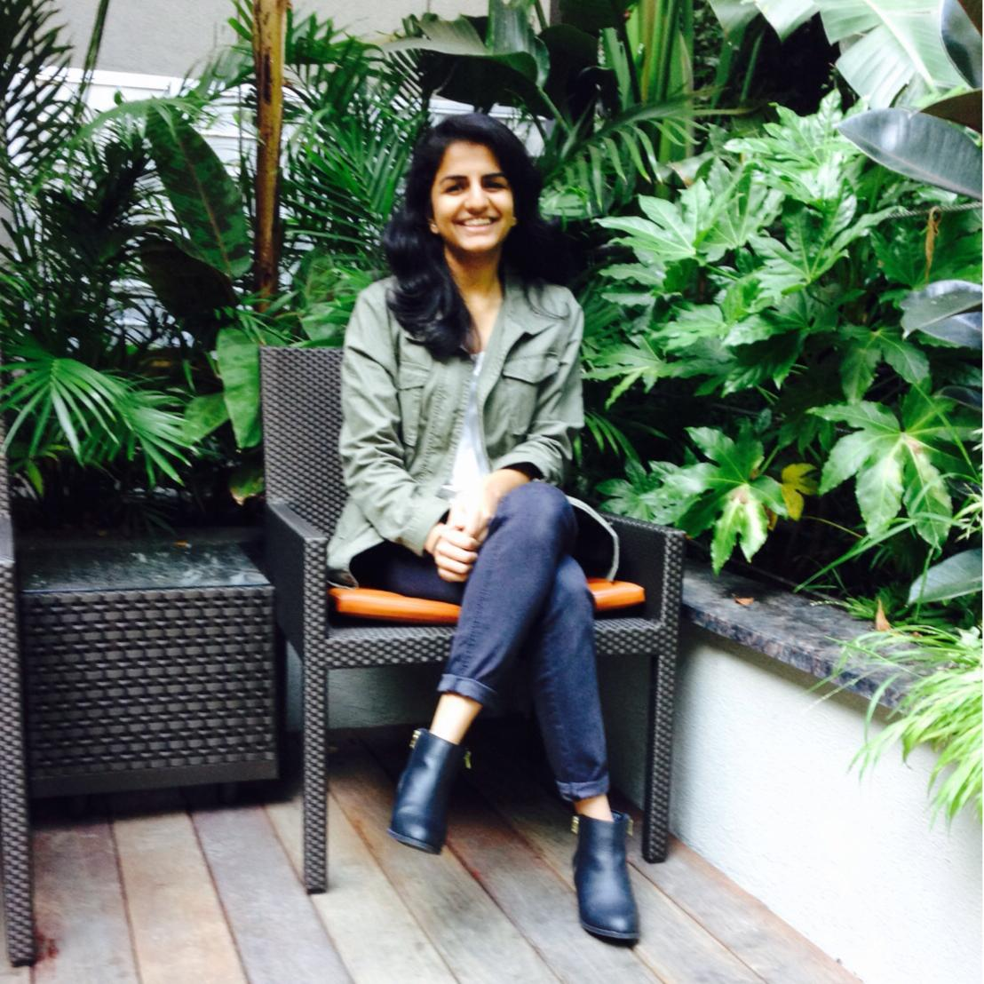
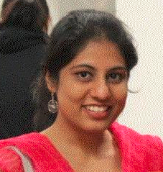
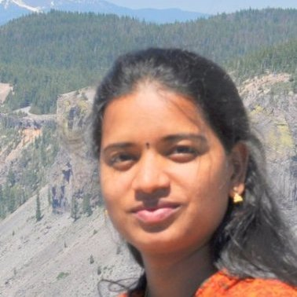

CONGRATULATIONS!

